Slide 1

OSLO Core Consent
Welcome! We will start at 1:05pm.
Thursday 21st October 2021
Virtual Workshop - Microsoft Teams
Digitaal Vlaanderen

Slide 2

Purpose of today
Summary context & first thematic workshop
Presentation of consolidated use cases and issues identified during the previous workshop
Brainstorming on how to address the main issues

Slide 3



Practicalities
Sound of the audience is muted by default.
Use the hand if you want to say something. Interaction is encouraged!
Questions, comments and suggestions can be communicated via the chat function. Interaction is encouraged!
Yes/No questions can be answered via the chat:
Agree = +1
Disagree = - 1
Indifferent = 0

Slide 4

Recording

Slide 5


Agenda
Welcome: Who is who 5 min
The reason for this trajectory 10 min
Summary of the previous workshop 15 min
Elaborate on use case 1 45 min
15 min. break
Elaborate on use case 2 45 min
Q&A and next steps 10 min

Slide 6
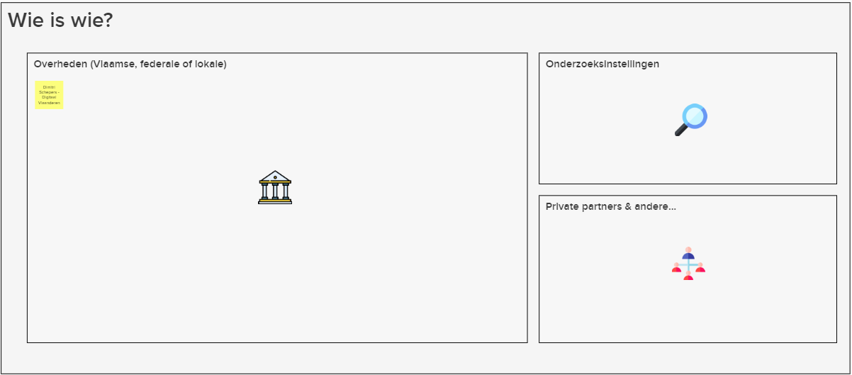

Who is who?
5’
https://app.mural.co/t/beadvtc7549/m/beadvtc7549/1634735142151/d14fb536ada06e7366c662b7ae80f57f44b0f6c1?sender=u91199267117038c13b019919

Slide 7
Rationale for this trajectory and summary of the previous workshop
Digitaal Vlaanderen

Slide 8
What is TRAPEZE?
TRAPEZE is a project, financed by the European Commission, that delivers a platform as a solution for organisations and citizens with some concrete objectives on security and privacy.
It aims to:
Bring stakeholders together under a common framework;
Provide citizens with the necessary tools and know-how to manage their security and privacy;
Supporte consent mechanisms and verifying that data is used appropriately;
Restore citizens' trust in the digital economy by implementing 'log integrity' and 'non-repudiation';
Build up 'data lineage' and 'transparency by design' and
Illustrate its usefulness by applicing it in 3 domains, namely government, telecom and financial sector.
Notes:
Anthony

Slide 9
What is expected?
Common data standard for “consent”
The objective of this project is to manage the consent of an agent’s data exchange in a uniform, standardised and machine-interpretable manner.
2-part objective, namely:
OSLO trajectory
Application profile for a wide range of use cases, i.e.:
As a citizen
As a business party using a permission
Use cases relating to delegation of consent
Co-creative trajectory for the development of an unequivocal data standard concerning core consent.
Involving the main stakeholders (federal and regional authorities, local authorities, private organisations) in order to develop a data standard that is supported as broadly as possible

Slide 10
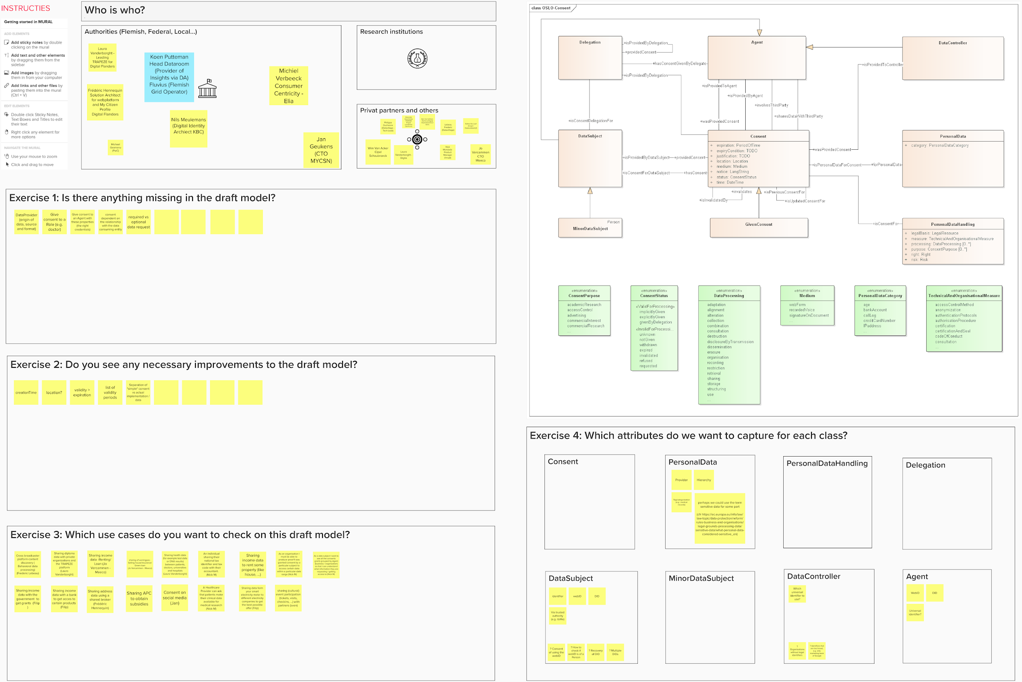


What did we do in the previous workshop?
UML introduction
Build draft model based on the assembled use cases
Brainstorm session
Basic terminology:
- Unified Modelling Language
- Concepts
- Relationships
- Attribution
Example
Use case generalisation
Presenting draft model
Exercise: Does this model allow for all relevant use cases?
Is there anything missing in the draft model?
Do you see any necessary improvements of the draft model?
Which use cases do you want to check on this draft model?
Which attributes do we want to capture for each class?

Slide 11
Most important issues/takeaways from workshop 1
Issues
How will the identity of the person giving consent be undebatable and clearly documented?
A consent requires an expression of expiry conditions.
How do we manage credential consent as an authentication system is bound to a individual (or organisation)?
How do we approach contextual requirements?
What is the difference between the relationship of a consent and the purpose of a consent?
How do we maintain the simplicity of a consent while covering every aspect of the consent?
Issues have been communicated via GitHub (https://github.com/Informatievlaanderen/OSLOthema-consent/issues)

Slide 12
How does the planning look like?
OSLO-traject
Start date: 19th of August 2021
Duration: 8 months
19th of August
23th of September
21th of October
18th of November
16th of December
January - March
Business workshop
Thematic workshop 1
Thematic workshop 3
Thematic workshop 4
Implementation of the draft specifications
Thematic workshop 2

Slide 13
Discussing the model via use cases
Digitaal Vlaanderen

Slide 14
Case 1 – Give consent to salary data for a mortgage loan
Kate is a customer of KBC bank.
She has both a current and a savings account.
Recently, she has her eyes set on a house, and applies for a mortgage loan at KBC.
KBC requests her three latest payslips to verify her eligibility and
to calculate an appropriate interest rate.
Kate gives consent for this via a web form and
specifies that the requested data can be retrieved from SD Worx.
She also specifies that her consent will be withdrawn once the offer is made.
KBC gives Kate an offer for her mortgage loan.

Slide 15
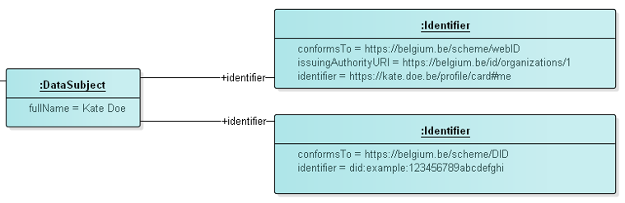
1 – Kate is a customer of KBC bank
Identification of a DataSubject:
How do we identify them?
Limit the options within this datamodel?
Leave open different options for identifiers?

Slide 16
2 – She has both a current and a savings account
Specific relationship between DataSubject and Agent
The need for a mortgage loan: different relationship
During step 5 we’ll go deeper into the difference between a relationship and a purpose

Slide 17
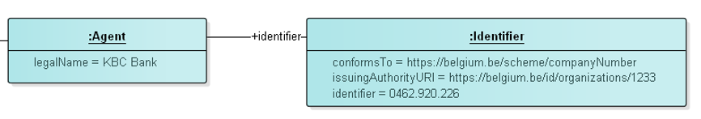
3 – Recently, she has her eyes set on a house, and applies for a mortgage loan at KBC
Identification of an Agent:
How?
Limit the options within this datamodel?
Leave open different options for identifiers?

Slide 18
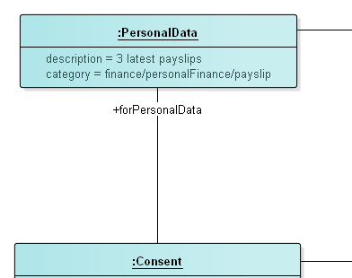
4 – KBC requests her three latest payslips to verify her eligibility
Identification of the requested data:
How do we do it?
What is the granularity we want to go into?

Slide 19
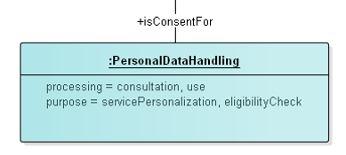
5 – Calculate an appropriate interest rate
Can you give some examples of relationship in which it differs from the purpose?

Slide 20
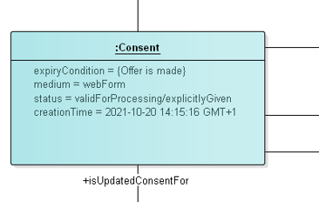
6 – Kate gives consent for this via a web form
What is shown to Kate?
Keep it simple enough for everyone to understand what they are giving consent to
Making it complete enough to cover the whole consent

Slide 21
7 – She specifies that the requested data can be retrieved from SD Worx

Slide 22
8 – She also specifies that her consent will be withdrawn once the offer is made
Expiry conditions of a consent: Are there any modelling languages you know of?

Slide 23
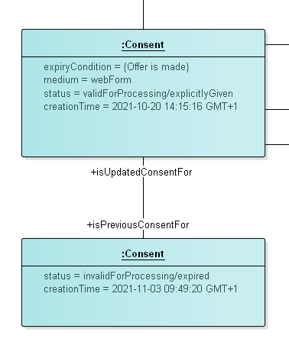
9 – KBC gives Kate an offer for her mortgage loan
GConsent makes a newer expired consent to indicate the expiry of a consent.
Risk: system always need to check if there is a newer version of the consent
Proposal: add expiryTime to the consent and keep it always up-to-date; if status changes duplicate an previous version

Slide 24

A short break...

Slide 25

Welcome back!

Slide 26
Case 2 – Give consent to blood group info in case of a medical emergency
On her way back from the bank, Kate is involved in a car accident. She is rushed to the hospital and is in urgent need of a blood administration.
Kate is unconscious, but luckily, she has already given consent to access her blood group in the past
in case of medical emergencies
w.r.t. healthcare professionals.

Slide 27
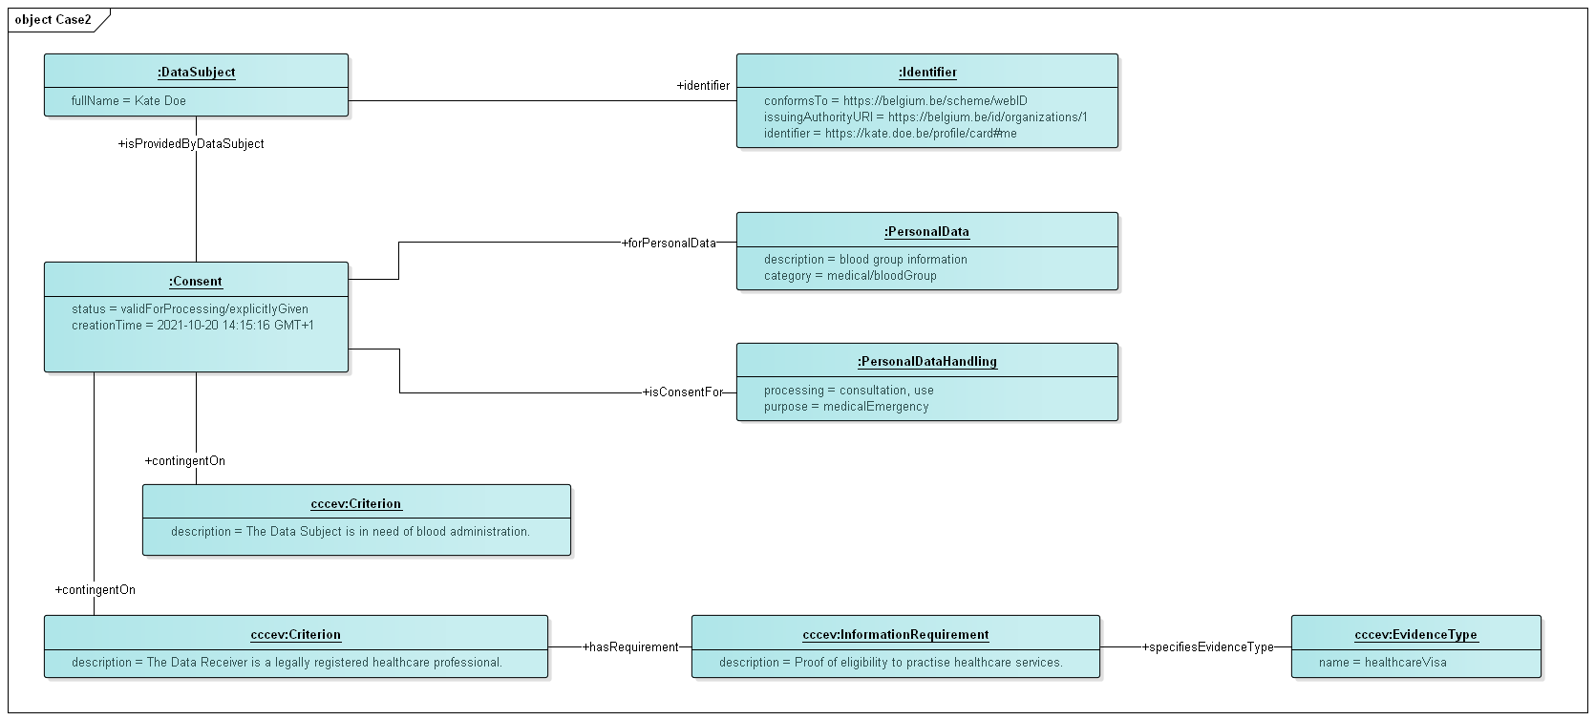
1 – On her way back from the bank, Kate is involved in a car accident. She is rushed to the hospital and is in urgent need of a blood administration.

Slide 28
2 – Kate is unconscious, but luckily, she has already given consent to access her blood group in the past

Slide 29
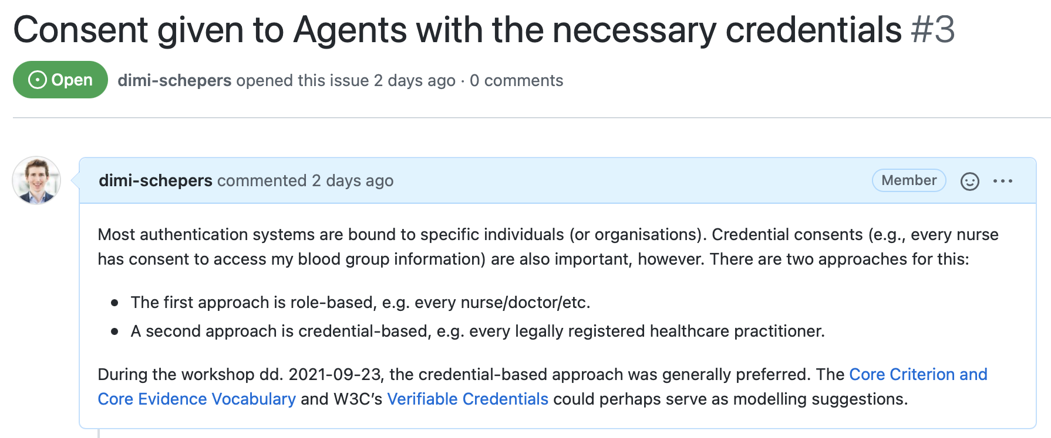
Issue nr. 3

Slide 30
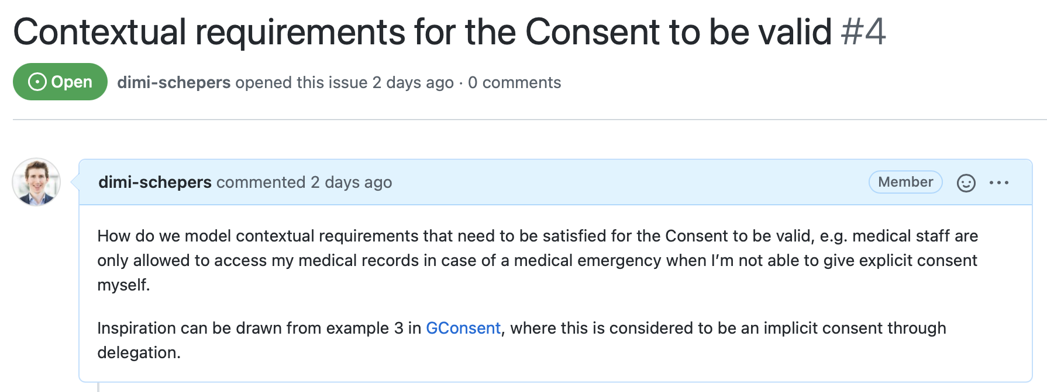
Issue nr. 4

Slide 31
3 – in case of medical emergencies

Slide 32
3 – in case of medical emergencies

Slide 33
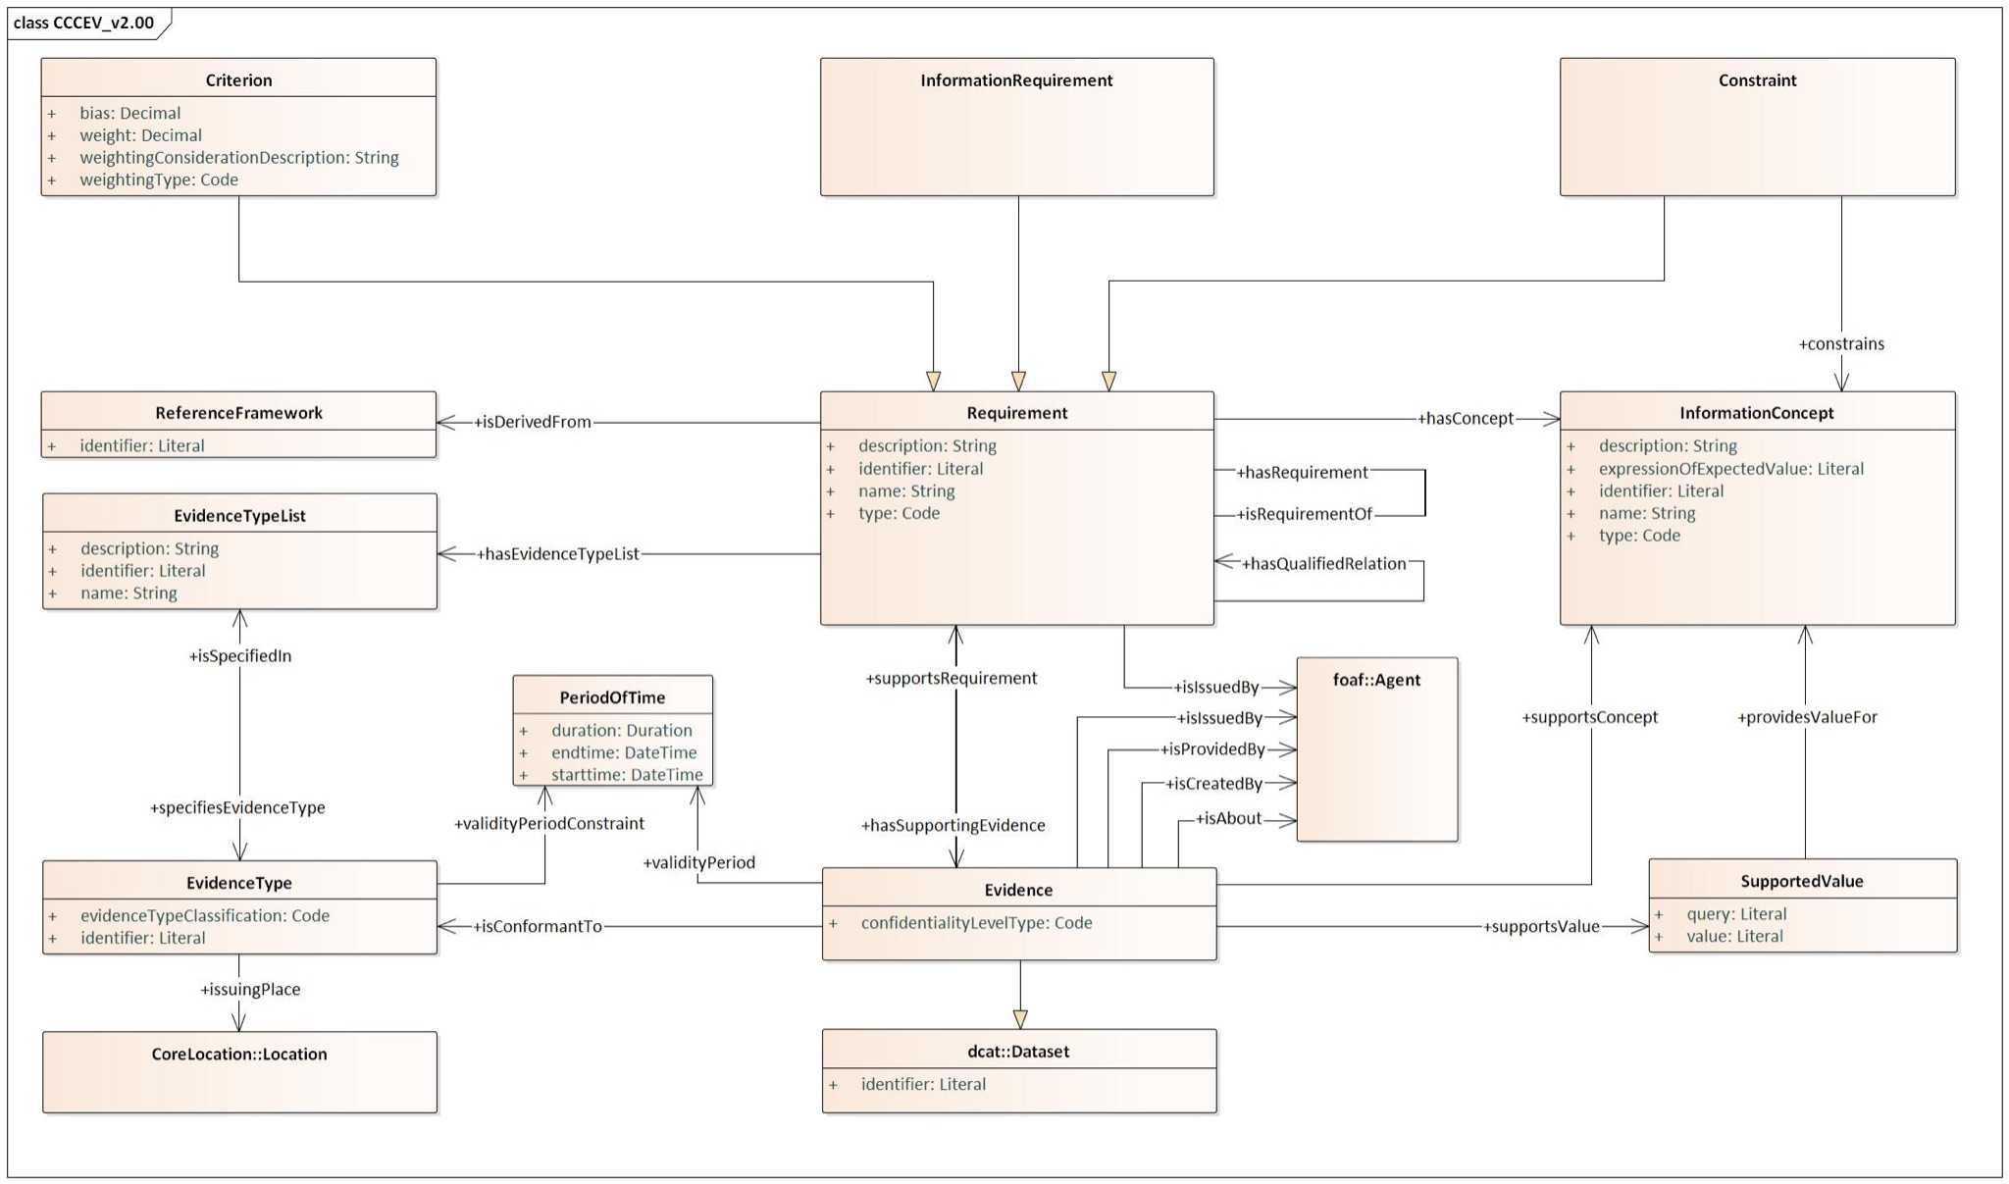
CCCEV

Slide 34
4 – w.r.t. healthcare professionals.

Slide 35
4 – w.r.t. healthcare professionals.

Slide 36
Q&A
Digitaal Vlaanderen

Slide 37

Why do we do ... ?
Wouldn’t it be better if we ... ?
Don’t we need to add ... ?
What about ... ?

Slide 38
Next steps
Digitaal Vlaanderen

Slide 39
Next steps
Processing all input from this workshop.
Sending out the report from this workshop. Feedback is certainly welcome!
Capture feedback via GitHub!
Iterate draft of semantic model.

Slide 40

Feedback
Feedback can be given via mail to the contacts below:
laurens.vercauteren@pwc.com
michael.geamanu@pwc.com
Feedback can be given via GitHub on the link below:
https://github.com/Informatievlaanderen/OSLOthema-consent

Slide 41
Thematic workshop (OSLO)
Today
19th
Business
werkgroep
21th
Thematic
workshop 2
16th
Thematic
workshop 4
August
September
October
November
December
23th
Thematic workshop 1
18th
Thematic
workshop 3
23th
Start public
review
Next workshop
Don’t forget to register!
https://overheid.vlaanderen.be/opleiding/oslo-trapeze?_cldee=a2V2aW4uaGFsZXlkdEB2bGFhbmRlcmVuLmJl&recipientid=contact-6ce4a8517dd3e811a972000d3ab98582-989da9acbb4241e4829946d2e8a0e828&esid=a14015bf-09d4-eb11-bacc-000d3adccc13

Slide 42
Thank you!

